Slide 1
NeuMa Dataset: EEG-based Neuromarketing Analysis
By Vishal Ubnare (MSc. Cognitive Science)
Instructor: Dr.Krishna Prasad Miyapuram

Slide 2
Contents
Slide
Introduction ………………………… 3
Methods ………………………… 4
Figures and Graphs …………………………. 5
Key Neuromarketing Correlations …………..…… 9
Results …………………………………… 10
Interpretation …………………………………… 12
Conclusion …………………………………… 13
Limitation …………………………………… 14
References …………………………………… 15

Slide 3
Introduction
Neuromarketing combines neuroscience and marketing to better understand consumer behaviour.
Traditional surveys are subjective; EEG offers objective insights into attention, engagement, and decision-making processes.
The NeuMa dataset captures EEG, eye-tracking, demographics, and product selection during a simulated online shopping experience.
Goal of this Study: Analyse EEG patterns linked to product selection and demographic profiles to uncover neural correlates of buying behaviour.

Slide 4
Methods
Participants (N = 42) browsed digital supermarket brochures.
They selected products they intended to purchase using a mouse click.
Recordings included:
Resting-state EEG (2 minutes before task)
EEG during browsing
Eye-tracking
Demographics & profiling questionnaires
Freedom of Choice: Participants chose without restrictions on budget or quantity.
Behavioural Grouping: Group products based on Bought vs Not Bought.
EEG data were segmented based on product viewing timestamps, filtered into alpha (8–12 Hz) and beta (13–30 Hz) bands, and average power was computed for each segment. Products were labelled "Bought" or "Not Bought" to compare neural responses. Short segments were excluded, and correlations with demographic and profiling variables were explored to understand consumer behaviour patterns.

Slide 5
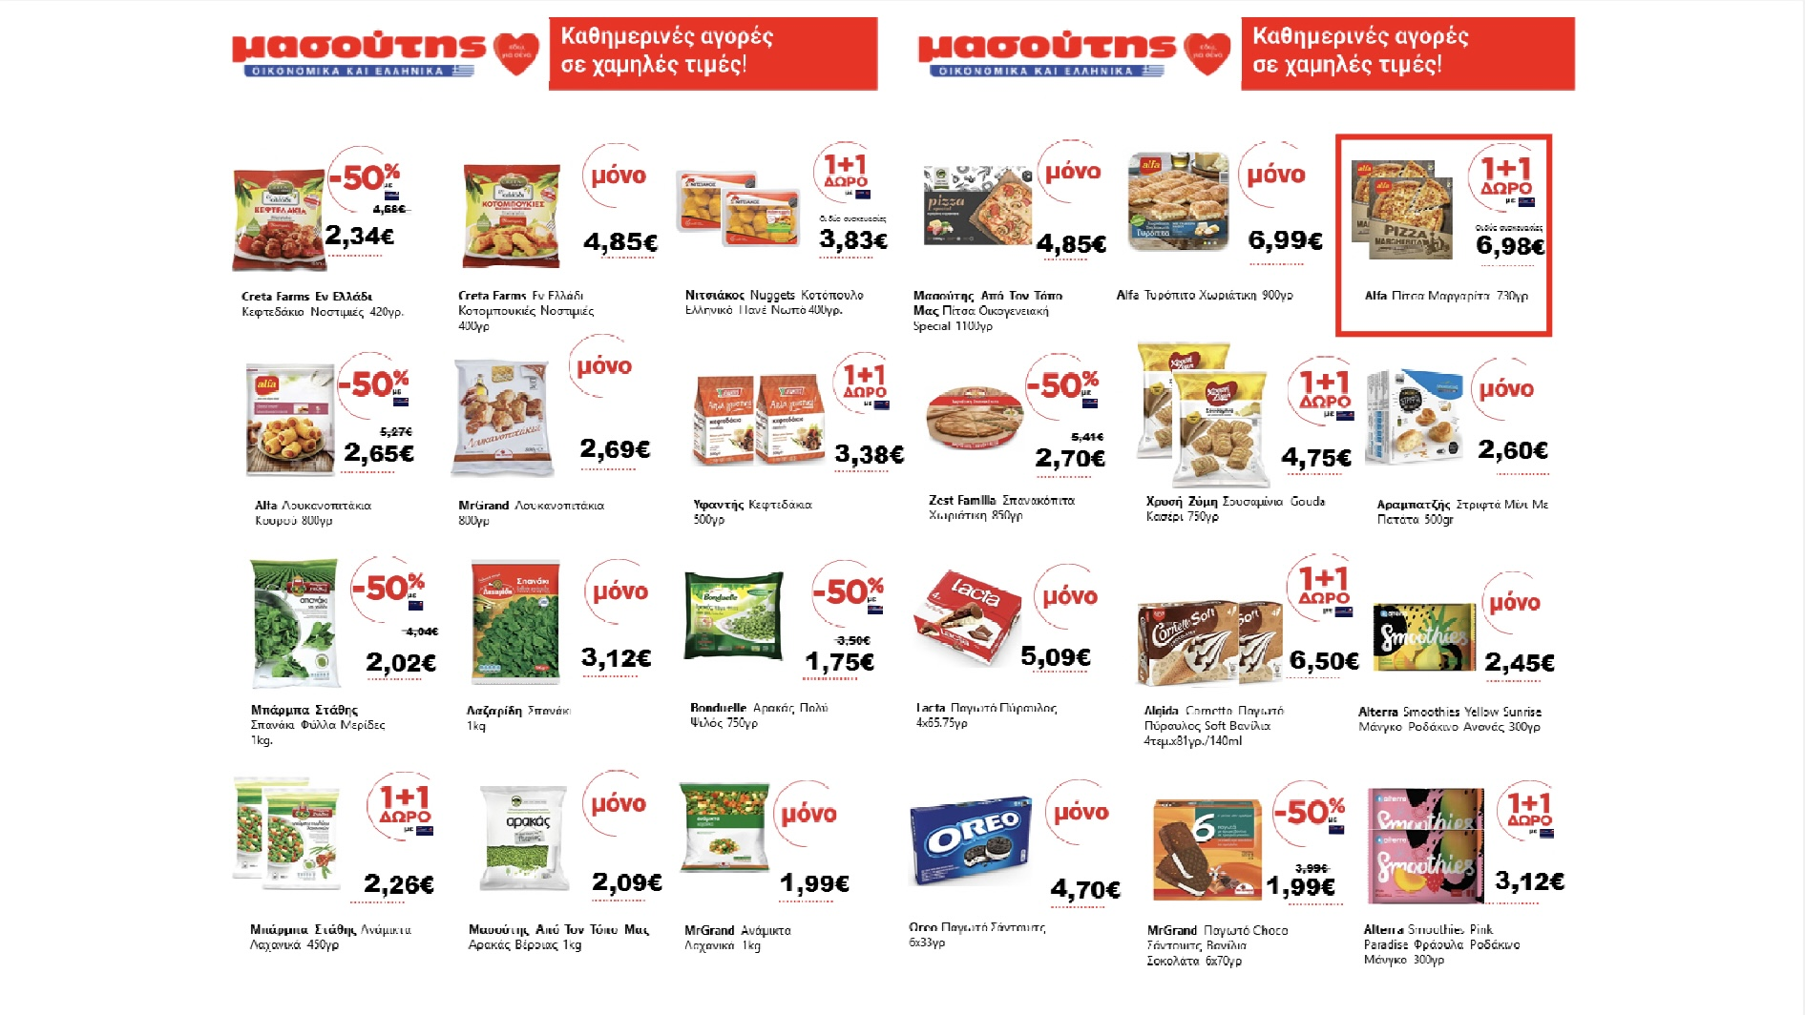
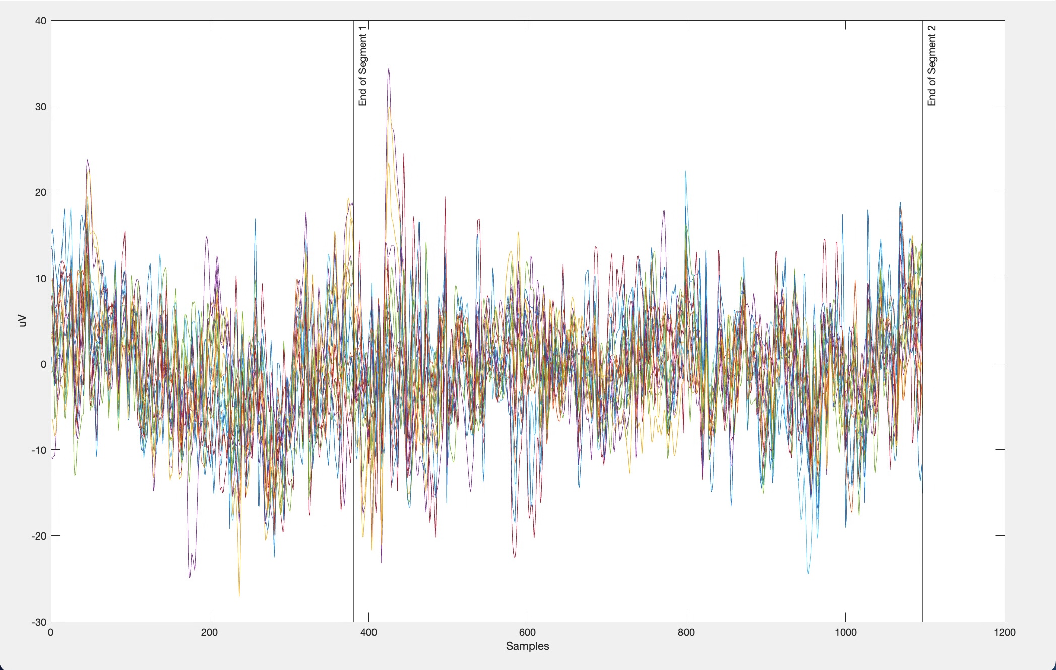
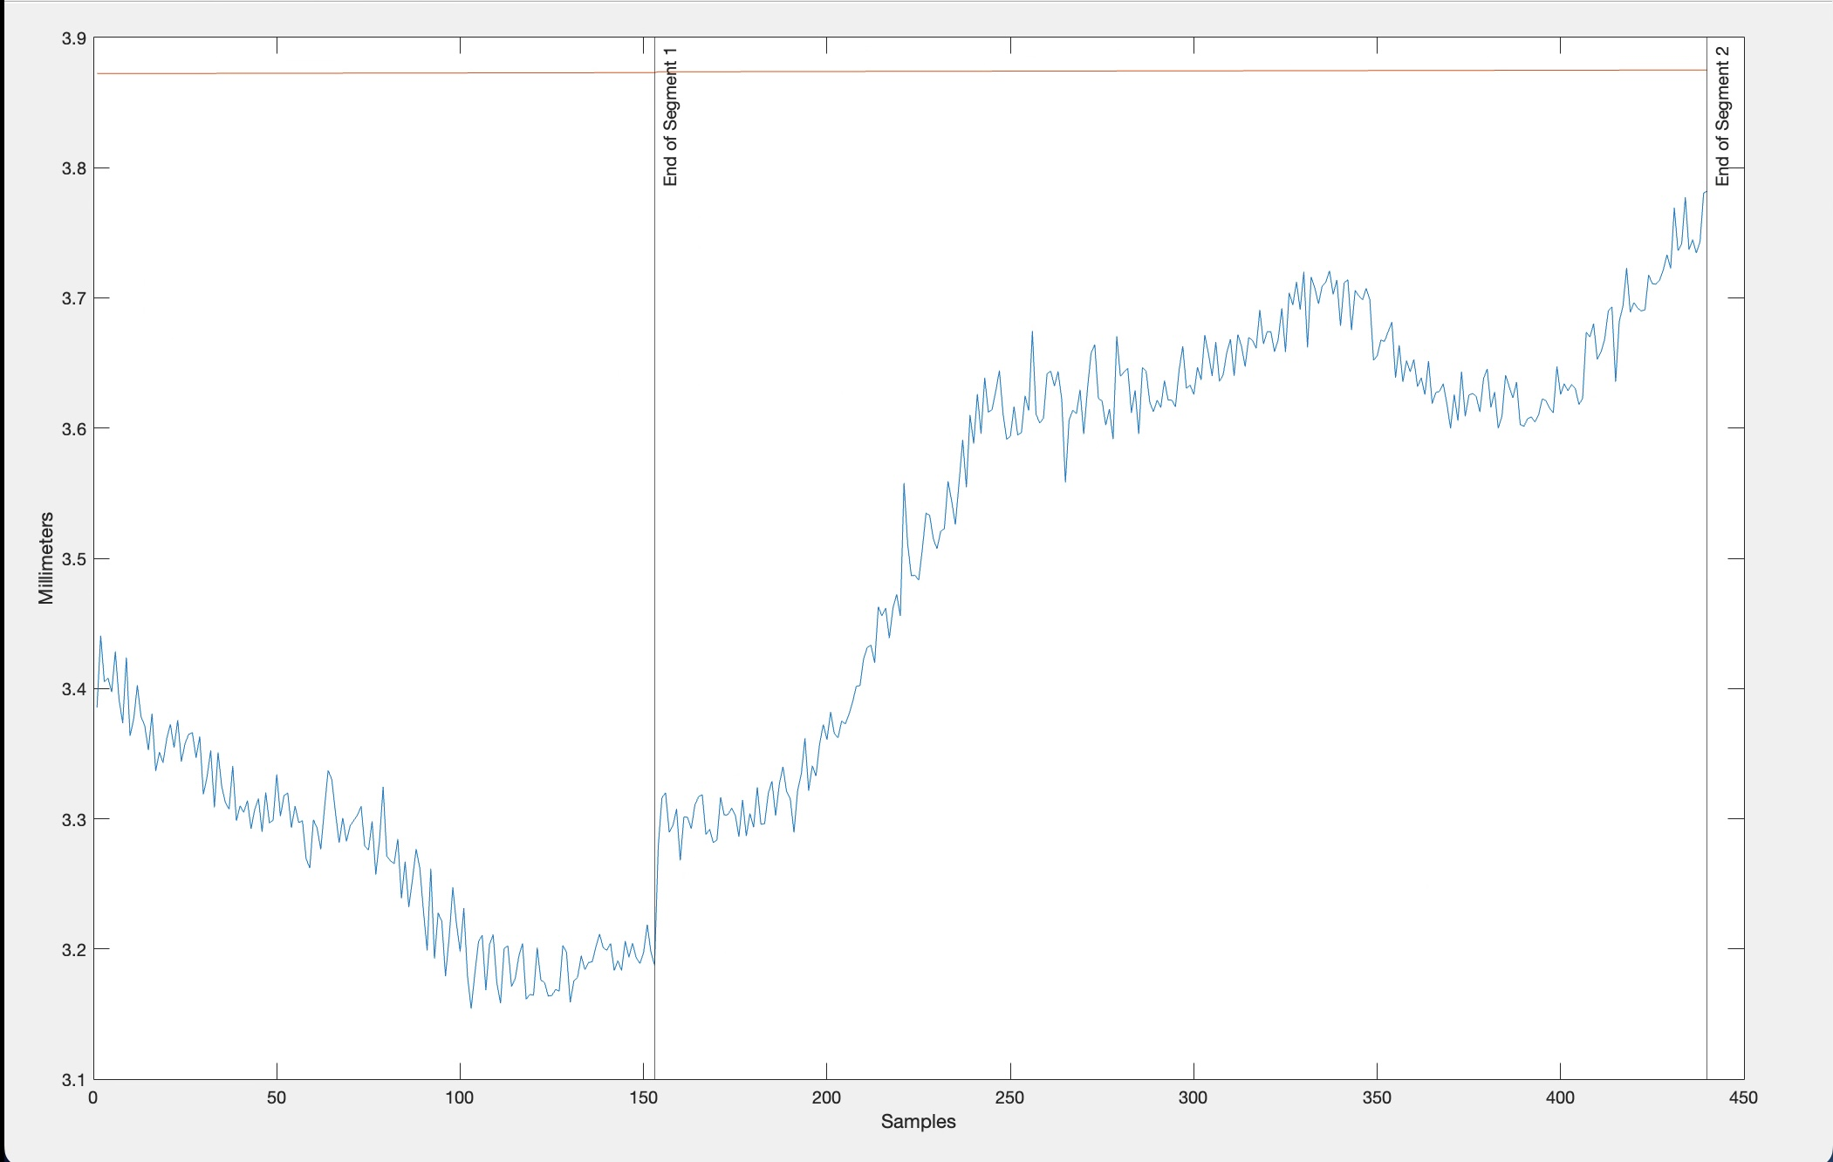
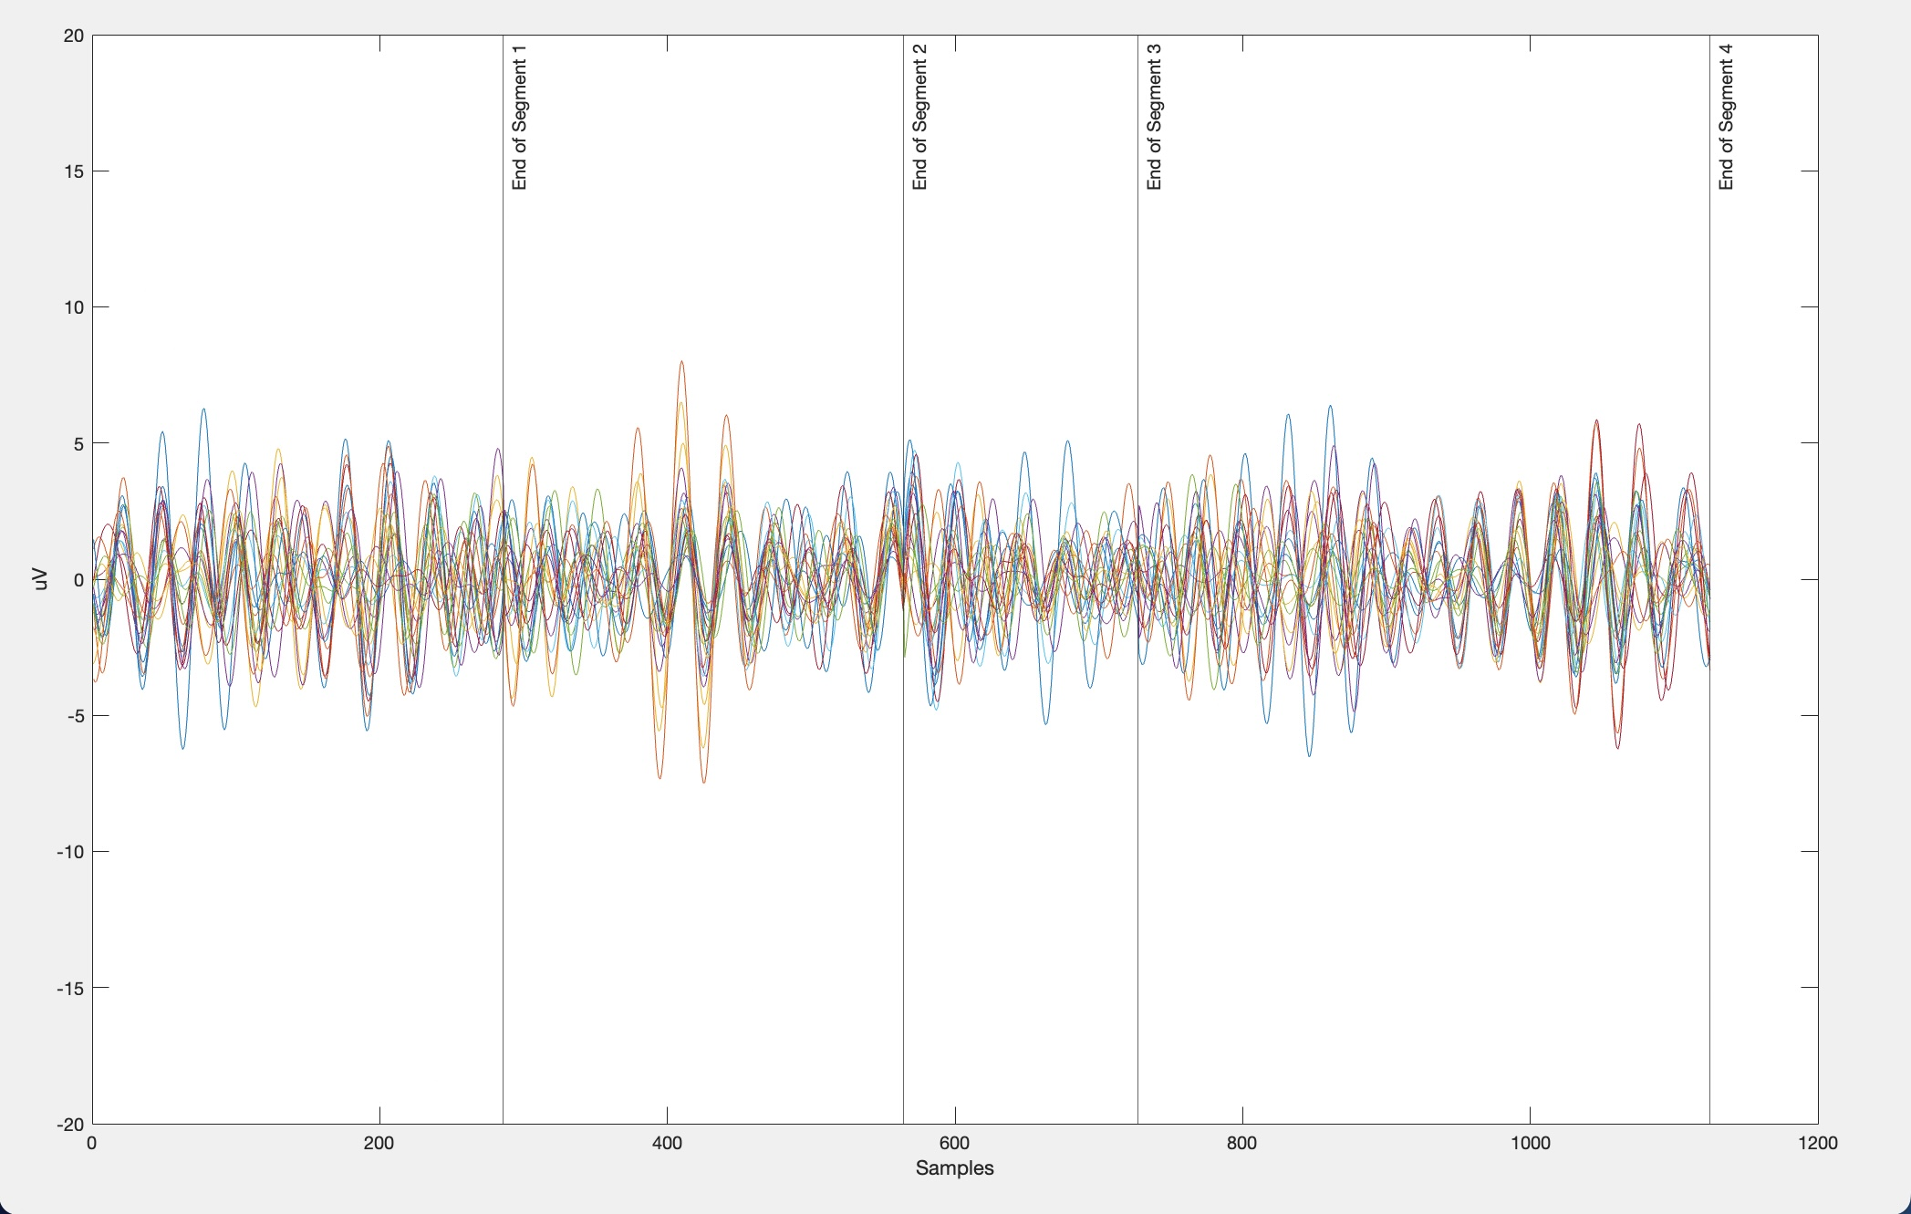
For S07
Fig.1(a) Advertisement Brochure
Fig.1(b) EEG Processed Data
Fig.1(c) Eye Tracking
Fig.1(d) EEG Filtered Data

Slide 6
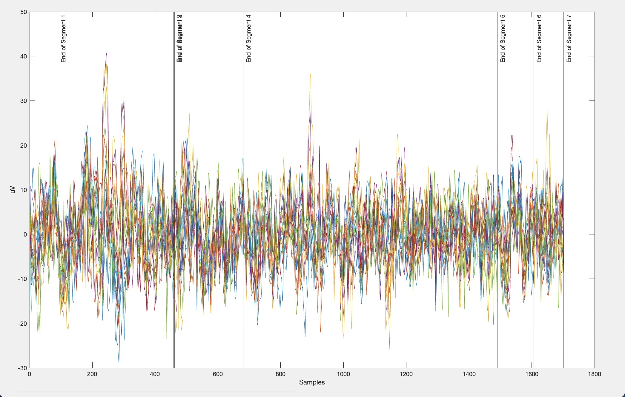
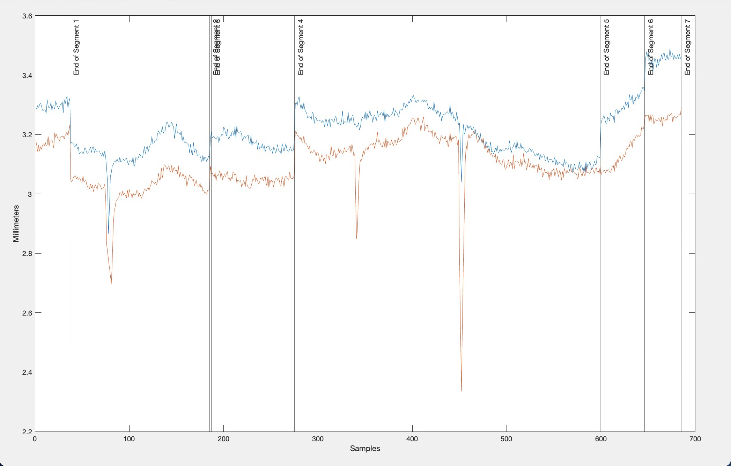
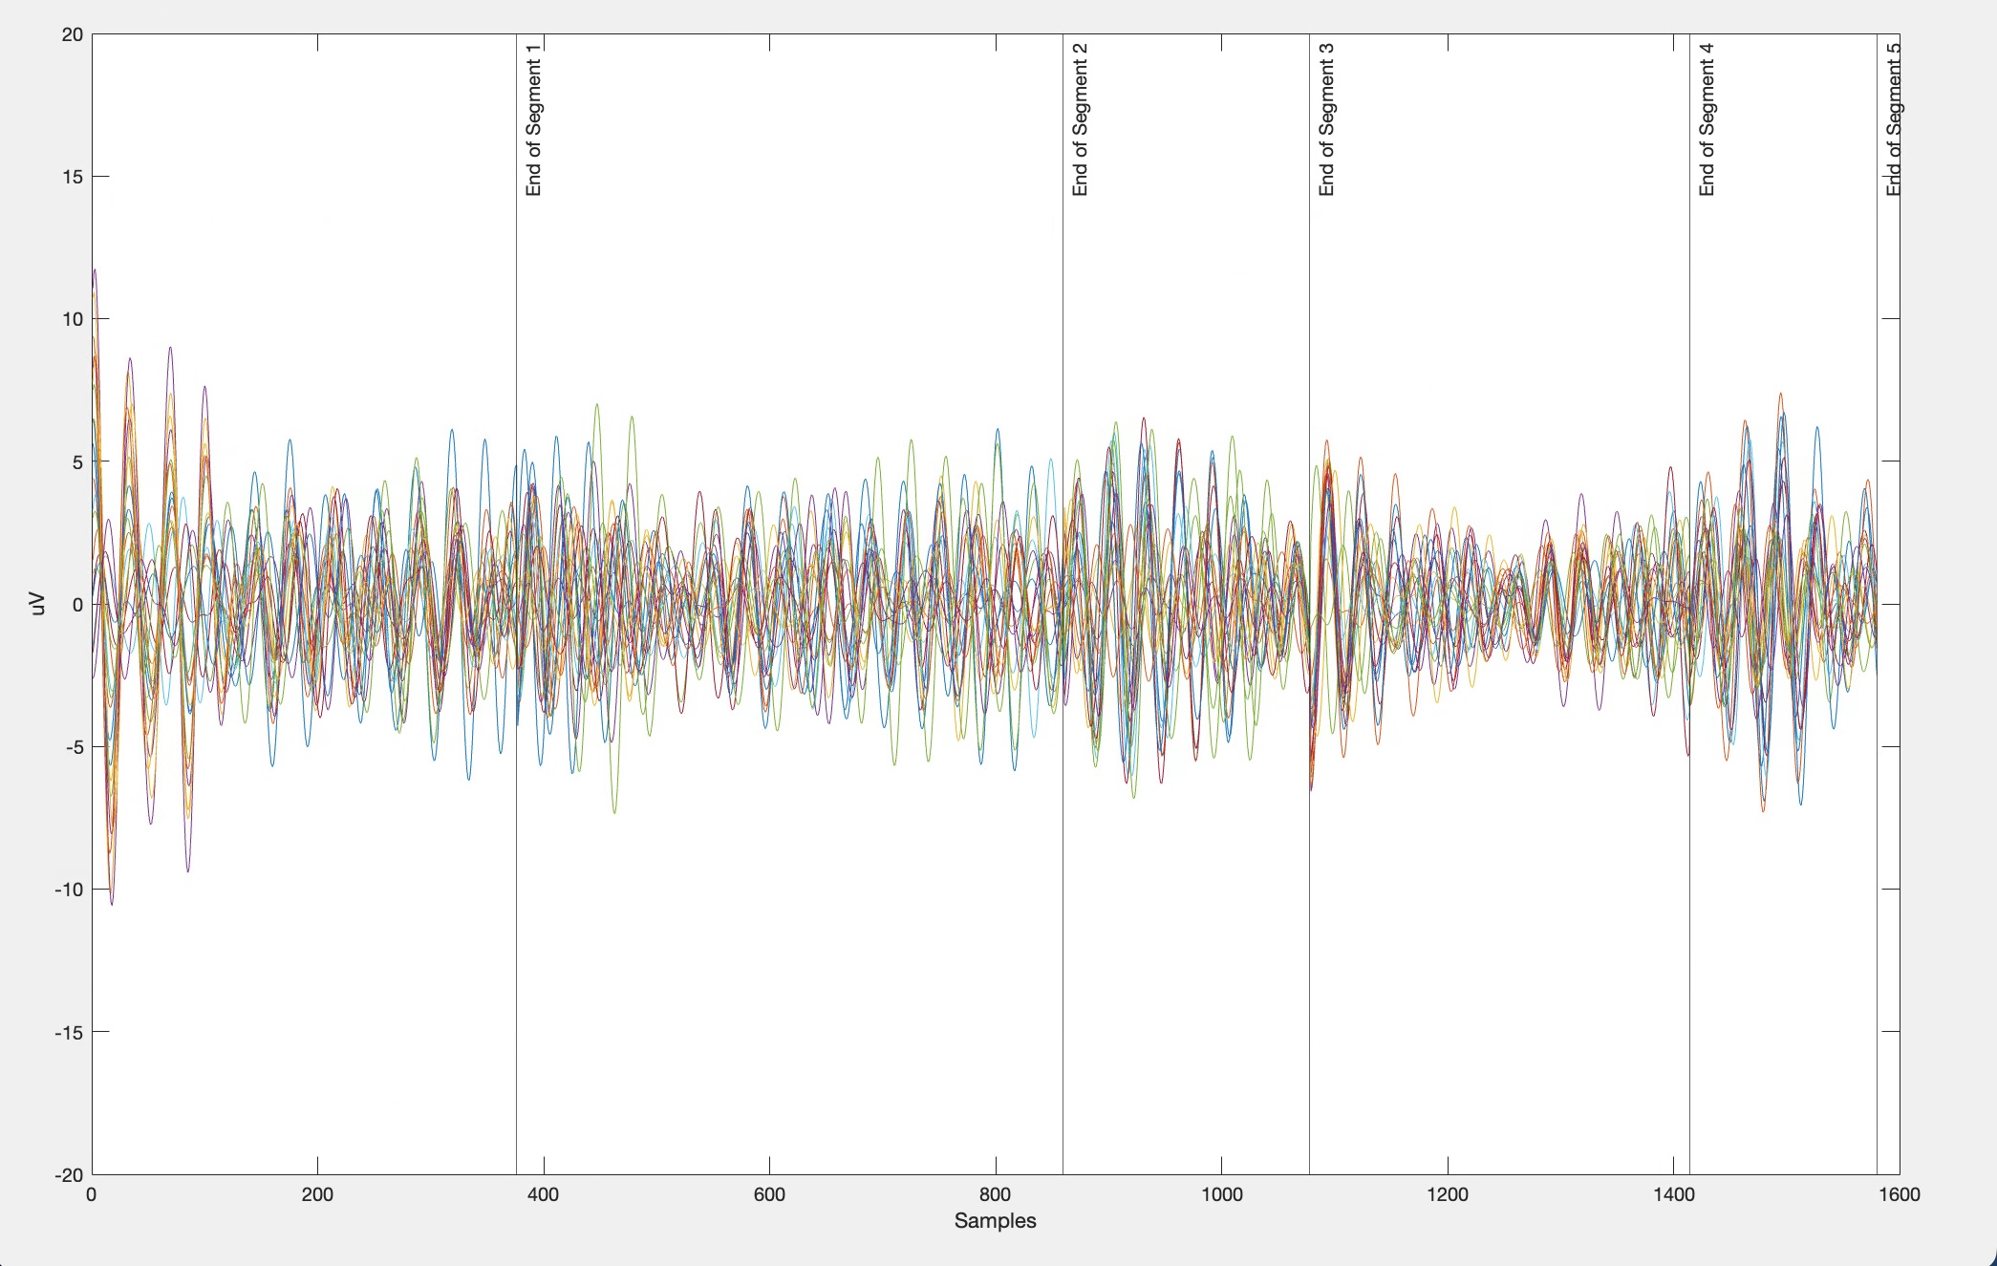
For S19
Fig.2(a) Advertisement Brochure
Fig.2(b) EEG Processed Data
Fig.2(c) Eye Tracking
Fig.2(d) EEG Filtered Data

Slide 7
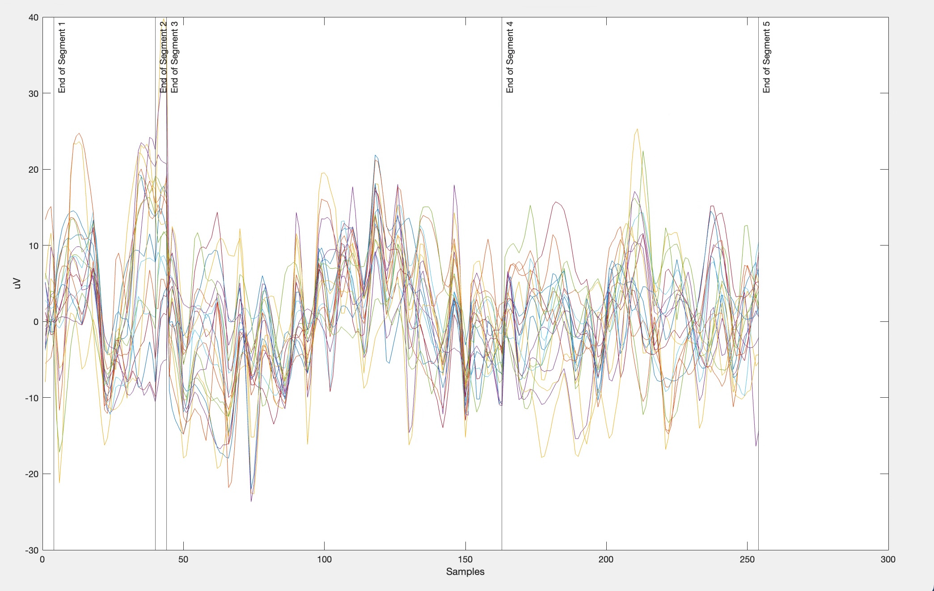
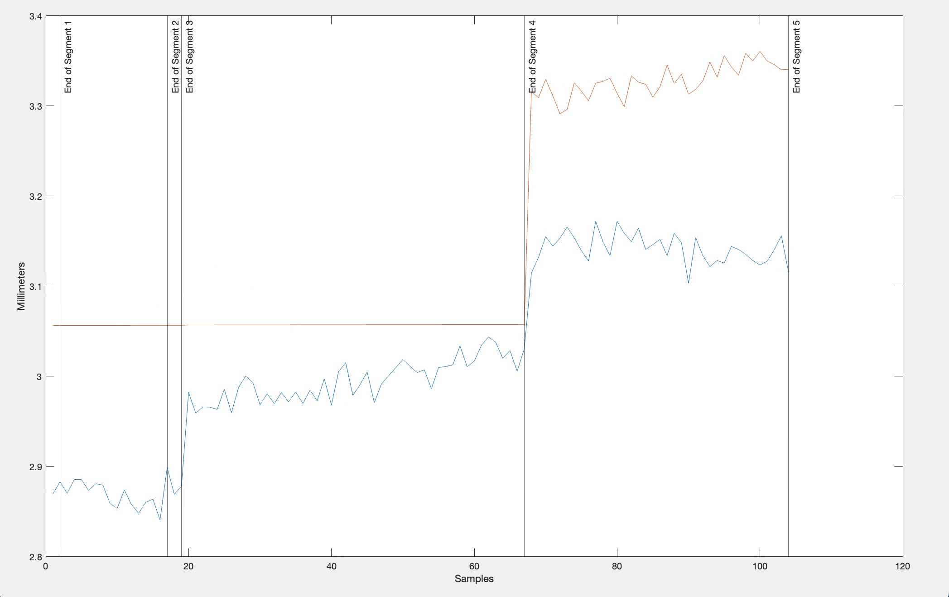
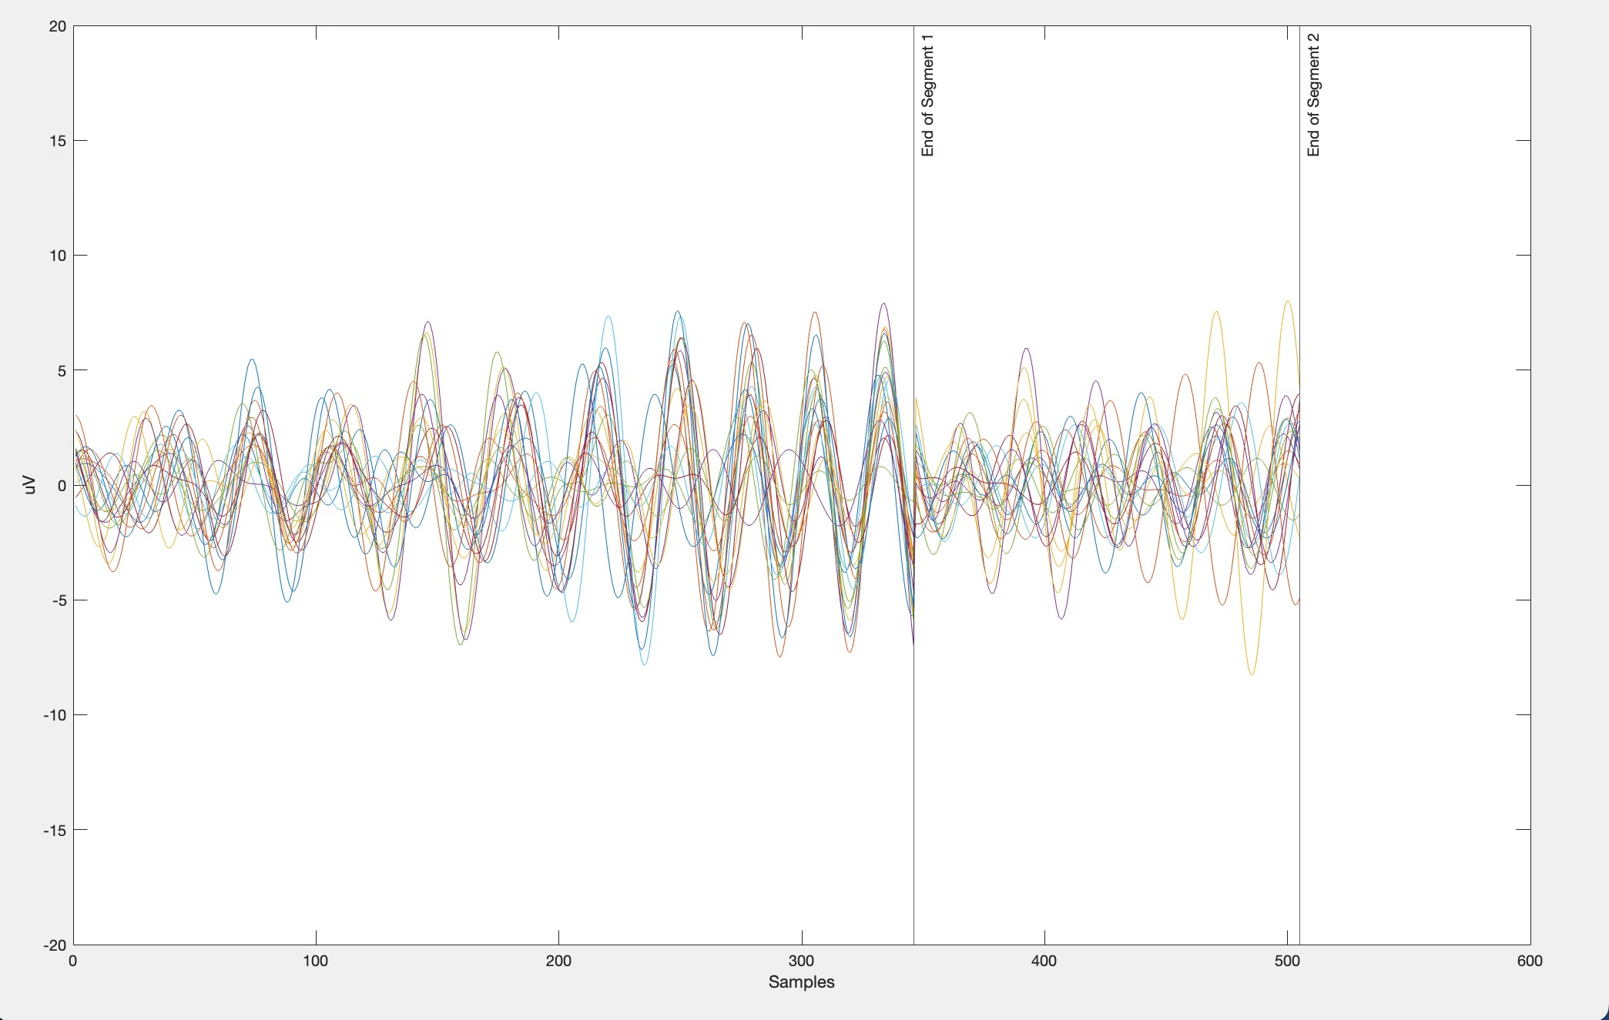
For S29
Fig.3(a) Advertisement Brochure
Fig.3(b) EEG Processed Data
Fig.3(c) Eye Tracking
Fig.3(d) EEG Filtered Data

Slide 8
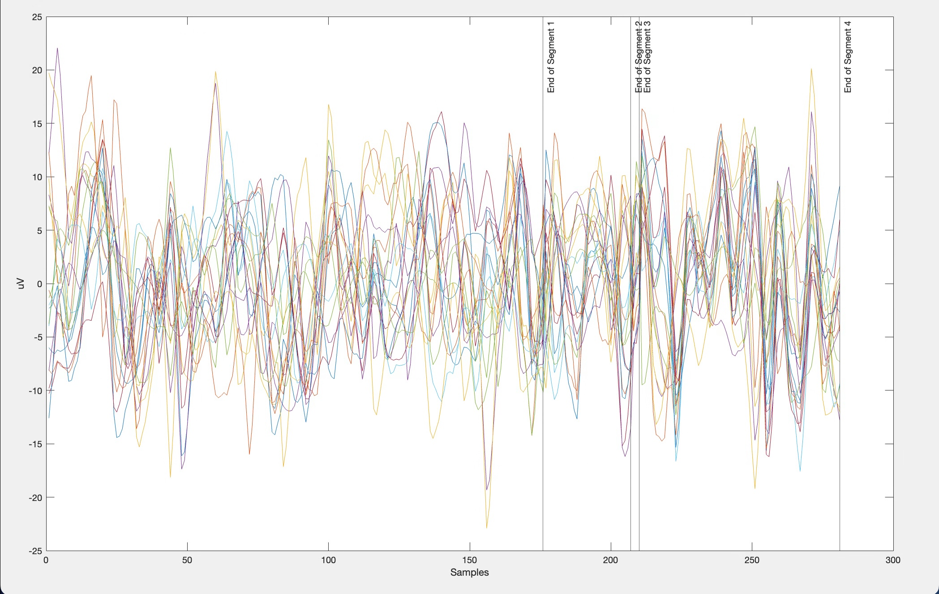
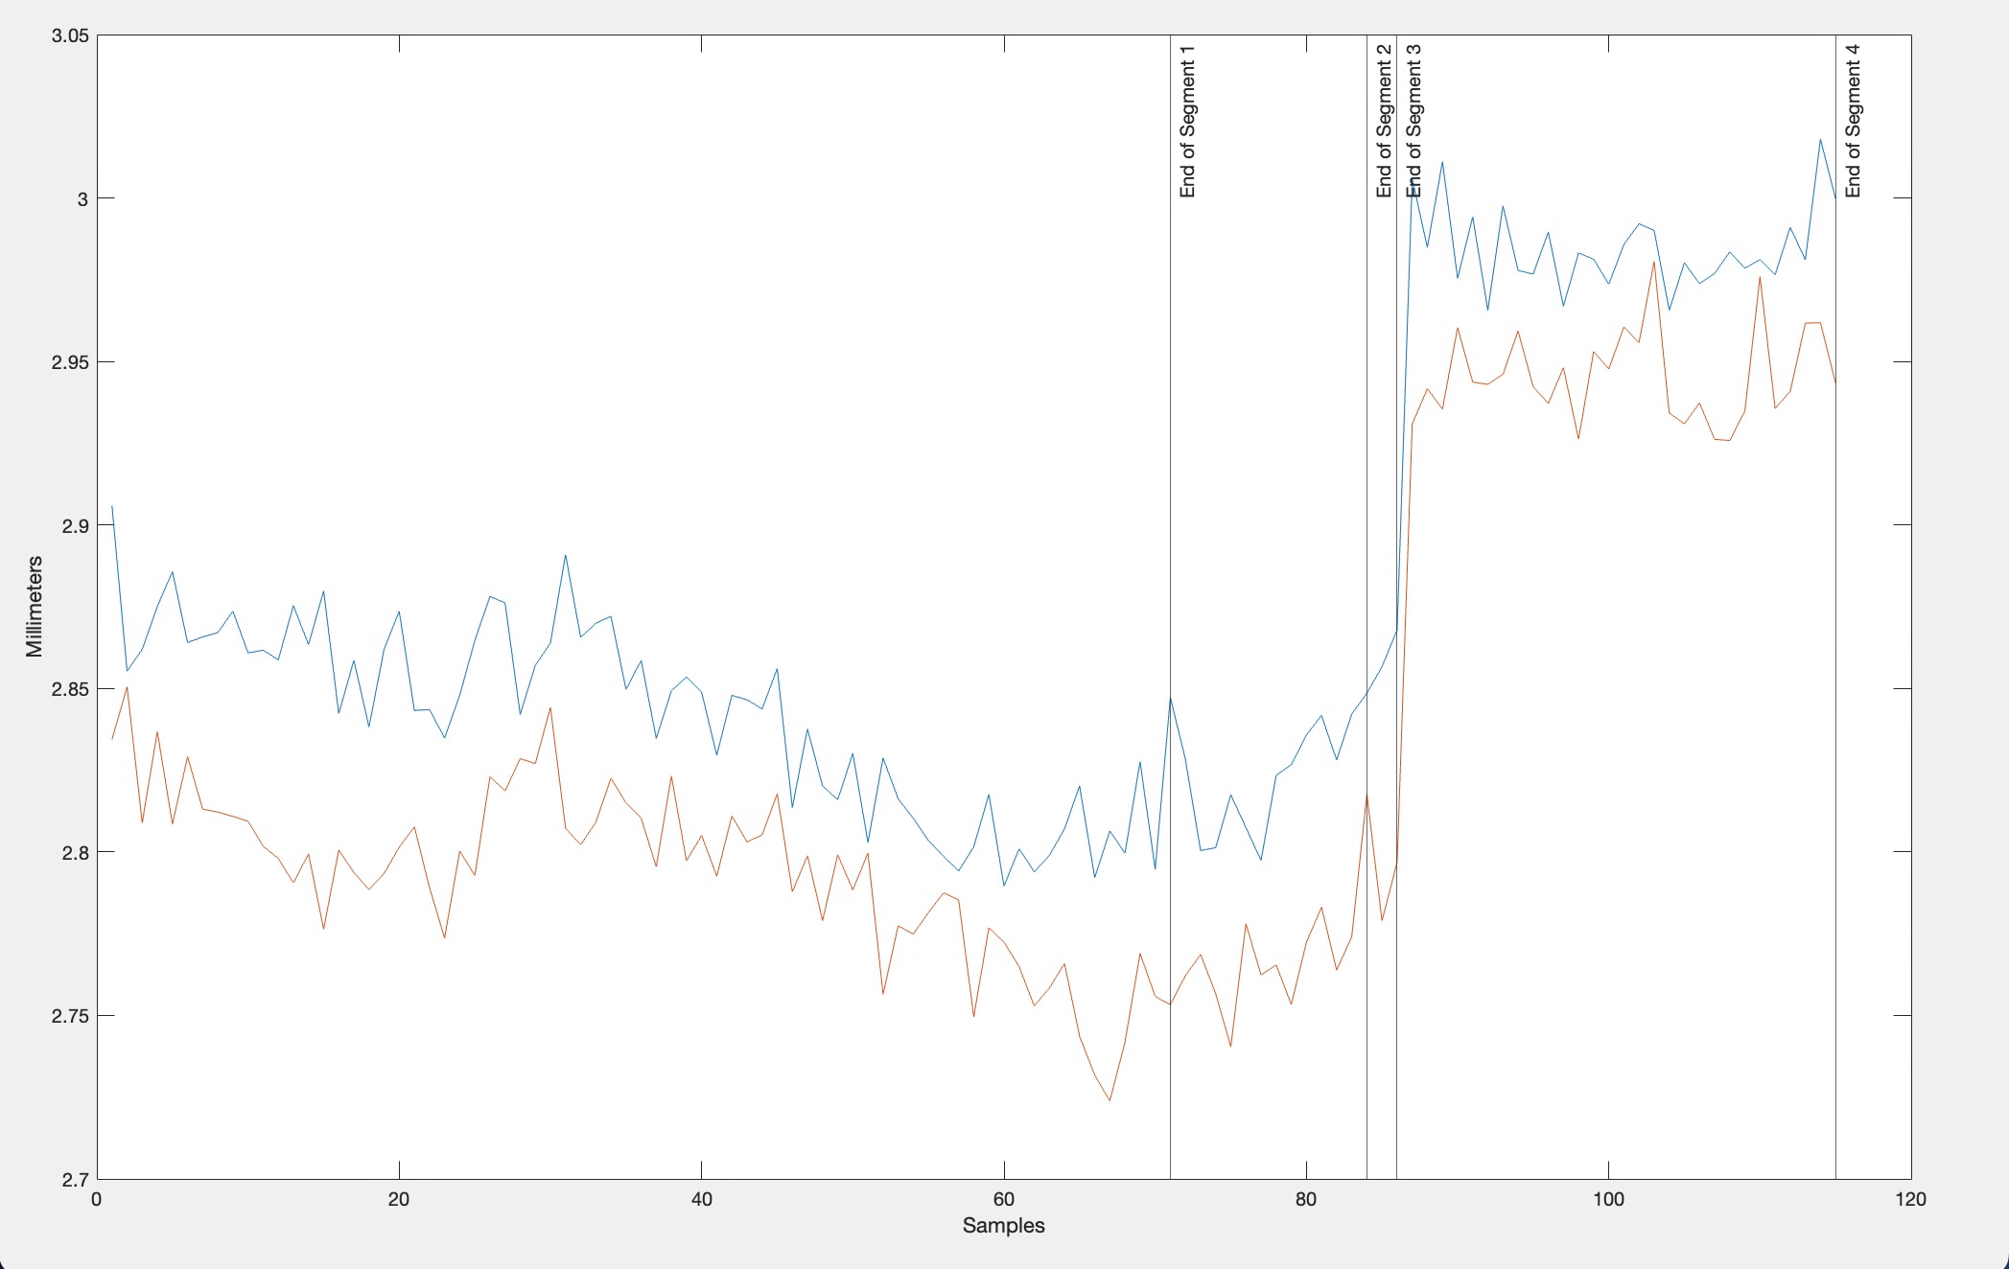
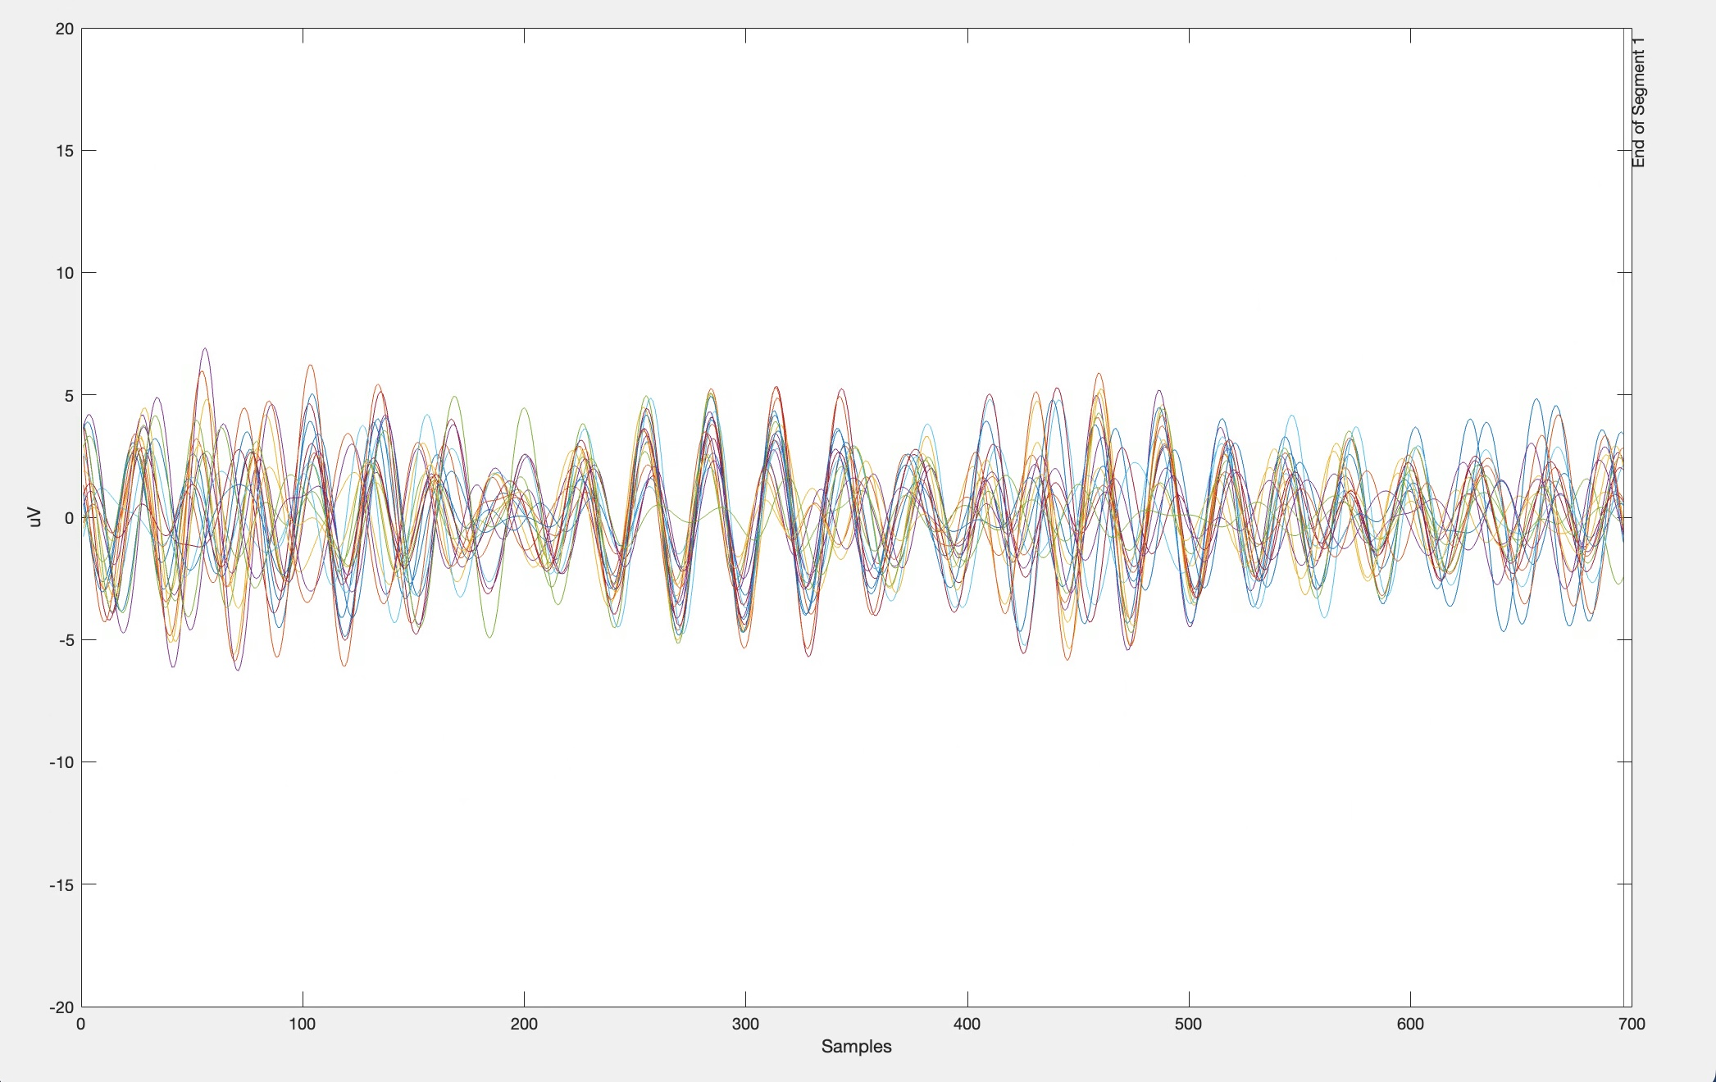
For S43
Fig.4(a) Advertisement Brochure
Fig.4(b) EEG Processed Data
Fig.4(c) Eye Tracking
Fig.4(d) EEG Filtered Data

Slide 9
Key Neuromarketing Correlations
Metric | Buyers (S07/S19) | Non-Buyers (S29/S43) | Behavioural Interpretation
Frontal Theta | Lower (4.2 μV²) | Higher (6.8 μV²) | Decision Conflict: Theta power is 62% higher among non-buyers, suggesting an internal conflict between price sensitivity and brand preference.This fits the profile of S29 (BrandImpact=9/10 vs. PriceImpact=9/10).
P300 Latency | Shorter (~300ms) | Prolonged (>500ms) | Attentional Overload: Non-buyers' delayed P300 brain responses indicated that they took longer to process information. This implies they struggled to concentrate effectively, most likely as a result of their increased education, which made them examine product details more closely before choosing a product.
Fixation Duration | Price-focused (320ms) | Brand-focused (480ms) | Visual Prioritization: Although non-buyers exhibit "analysis paralysis" despite strong brand loyalty, buyers' shorter price fixations demonstrate utilitarian decision-making.
Pupil Dynamics | Progressive dilation | Flat/erratic patterns | Emotional Engagement: Buyers' steady dilation indicates positive arousal toward discounts, while non-buyers' variable patterns suggest cognitive overload from competing motivations.

Slide 10
Results
Buyers (S07, S19)
EEG: Lower frontal theta and fast P300 indicate less decision conflict and more efficient, confident decision-making.
Eye Tracking: Shorter, price-focused fixations show practical, utilitarian shopping-quickly evaluating price and making a purchase.
Pupil Response: Steady dilation reflects growing engagement and positive emotional response to the product.
Behavior: These buyers are more likely to act on discounts and price cues, making decisions quickly and with less hesitation.

Slide 11
Non-Buyers (S29, S43)
EEG: Higher frontal theta and longer P300 latency suggest more internal conflict, overthinking, or uncertainty when evaluating products.
Eye Tracking: Longer fixations on brand elements suggest more time spent considering brand, possibly at the expense of making a decision.
Pupil Response: Flat or erratic patterns indicate less emotional engagement or possible cognitive overload.
Behaviour: These non-buyers are likely to hesitate or walk away from a purchase, especially if they experience conflicting motivations (e.g., liking the brand but worrying about price).

Slide 12
Interpretation
S07 is a practical, price and discount sensitive male who shops with a list and is highly influenced by suggestions from others. He is more verbal than visual, not very spontaneous, and moderately seeks variety. Utilitarian motivation dominates over hedonic. He is quite extraverted and open, with moderate agreeableness and conscientiousness.
S19 is a frequent, longer-duration shopper, highly sensitive to price and moderately to brand and discounts. Somewhat more visual than verbal, and a bit more spontaneous and variety-seeking than S07. He does not use a shopping list. Utilitarian and hedonic motivations are both present. He is extraverted but more neurotic and less agreeable than others.
S29 is extremely sensitive to price, brand, discounts, ads, and suggestions-the most marketing-responsive of the group. She is visual, not spontaneous, and moderately seeks variety. She shops with a list and is practical, but less driven by pleasure. She is extraverted, agreeable, and open.
S43 is nearly identical in profile to S07: practical, price- and discount-sensitive, highly influenced by suggestions, and shops with a list. She is more verbal, not very spontaneous or variety-seeking, and highly utilitarian. She is extraverted, open, and moderately agreeable and conscientious.

Slide 13
Conclusion
Buyers are practical and decisive, showing efficient neural and visual processing that leads to confident purchases.
Non-buyers experience more internal conflict and attentional overload, often overthinking brand vs. price, which results in hesitation or no purchase.
These neuromarketing insights help explain not just what consumers do, but why they do it-offering actionable guidance for targeted marketing strategies.

Slide 14
Limitation
Methodological Constraints
Small Sample Size (n=4): Limited statistical power and generalizability
Demographic Confounds: Gender and education differences perfectly align with purchase behavior (male/college=buyers; female/master's=non-buyers)
Artificial Environment: Laboratory setting may not fully replicate authentic shopping experiences and emotional contexts
Single Product Category: Analysis limited to frozen food section only
Technical Considerations
Signal Interpretation: EEG and eye tracking data subject to noise and interpretation challenges
Temporal Resolution: Brief viewing segments (<500ms) may not capture complete decision process
Causality vs. Correlation: Neural patterns correlate with but may not cause purchase decisions

Slide 15
References
NeuMa (PreProcessed): A multimodal Neuromarketing dataset. (n.d.). Retrieved April 27, 2025, from https://figshare.com/articles/dataset/NeuMa_PreProcessed_A_multimodal_Neuromarketing_dataset/22117124
Step by Step Process for NeuMa (PreProcessed): A multimodal Neuromarketing dataset. (n.d.). Retrieved April 27, 2025, from https://www.perplexity.ai/search/explain-me-step-by-step-accord-RYVS9bTwTjuNQtOjvBwRJw
For MATLAB Script and Analysed Data
https://github.com/Vishal8hz/Neuromarketing-.git

Slide 16
THANK YOU

